Slide 1
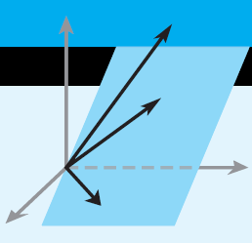
Elementary Linear Algebra
Euclidean Vector Spaces
Chapter 3
Notes:
*

Slide 2
Material in this chapter
3.1 Vectors in 2-Space, 3-Space,
and n-Space
3.2 Norm, Dot Product, and Distance in R^{n}
3.3 Orthogonality
3.4 The Geometry of Linear Systems
3.5 Cross Product
Notes:
*

Slide 3
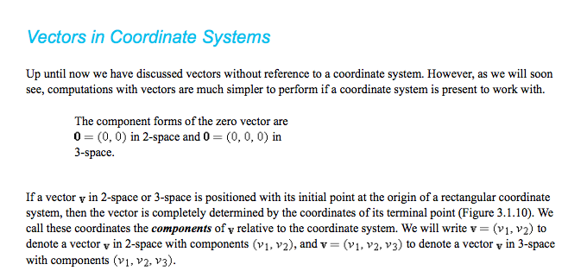

Slide 4
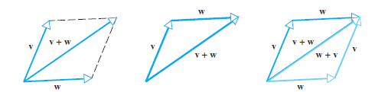
Vectors
Addition of vectors by the
parallelogram or triangle rules
Notes:
*

Slide 5
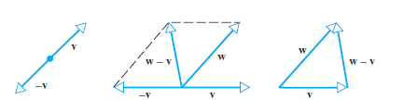
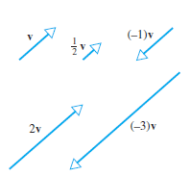
Subtraction:
Scalar
Multiplication:
Notes:
*

Slide 6
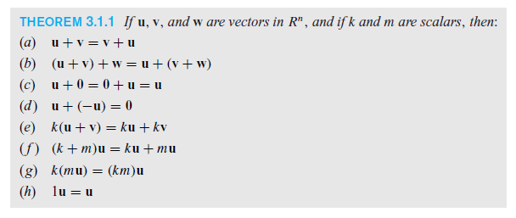
Properties of Vectors
Notes:
*

Slide 7
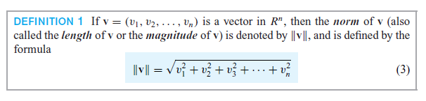

Norm, Dot Product, and Distance in R^{n}
Norm:
Unit Vectors:
Notes:
*

Slide 8
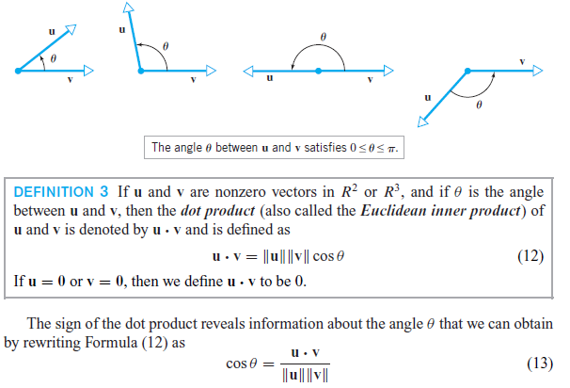
The Dot Product
Notes:
*

Slide 9
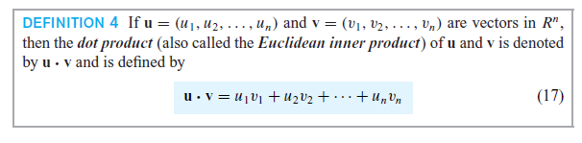
The Dot Product
Notes:
*

Slide 10
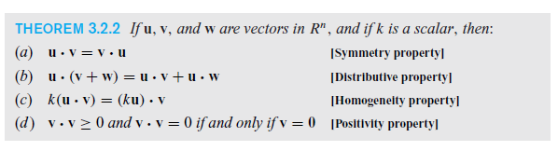
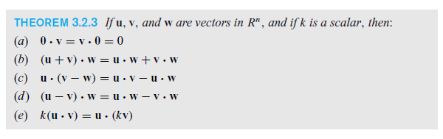
Properties of the Dot Product
Notes:
*

Slide 11
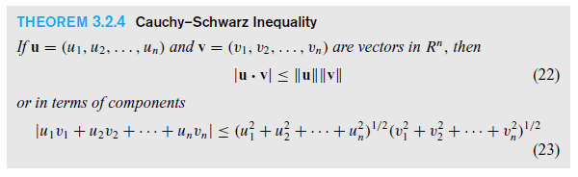
Cauchy-Schwarz Inequality
Notes:
*

Slide 12
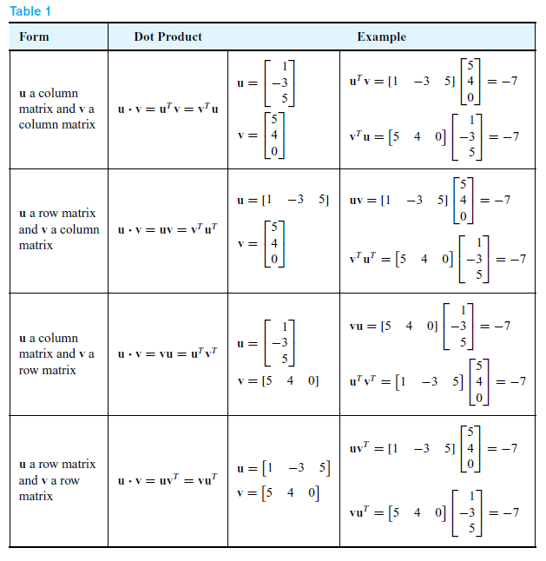
Dot Products and Matrices
Notes:
*

Slide 13
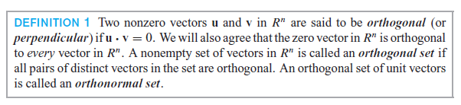
Section 3.3 Orthogonality
Notes:
*

Slide 14
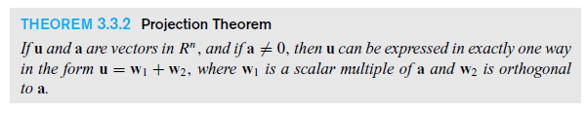

Orthogonal Projections
Notes:
*

Slide 15
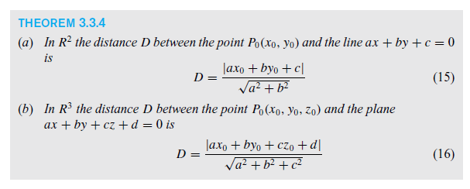
Point-line and point-plane
Distance formulas
Notes:
*

Slide 16
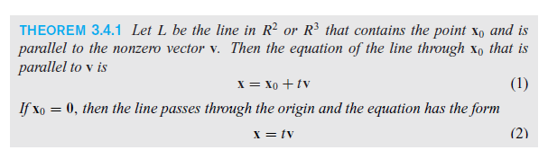
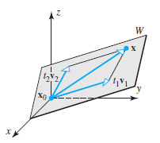
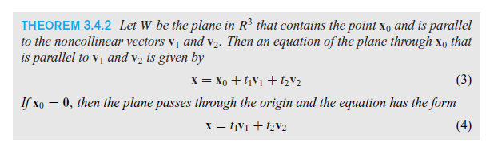
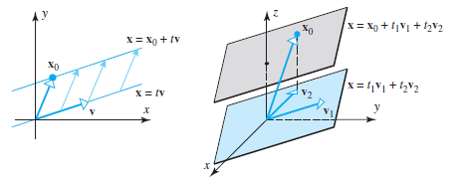
The Geometry of Linear Systems
Notes:
*

Slide 17
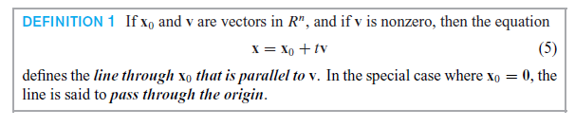
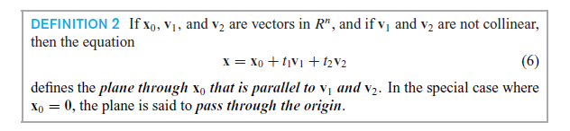
Notes:
*

Slide 18
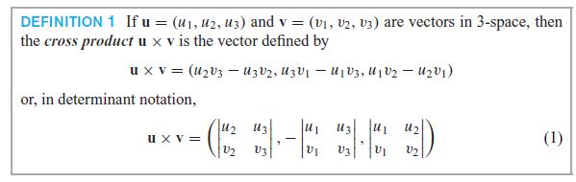
Cross Product
Notes:
*

Slide 19
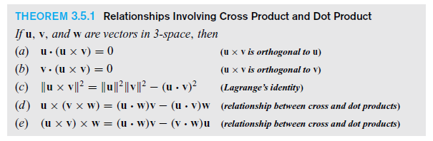
Cross Products and Dot Products
Notes:
*

Slide 20
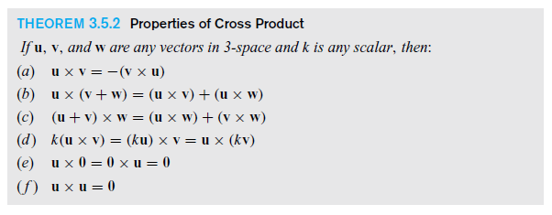
Properties of Cross Product
Notes:
*

Slide 21
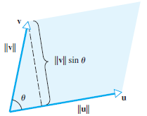

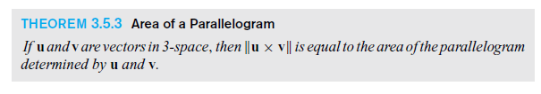
Geometry of the Cross Product
Notes:
*

